Slide 1
Gibbs Paradox &
Particle Indistinguishability
Thermal and Statistical Physics I
2026/10/15 Thu.
陳欣佑

Slide 2
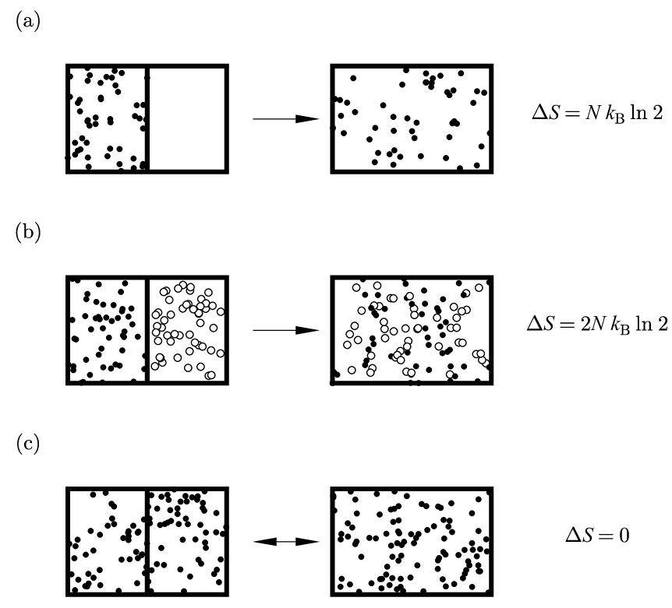

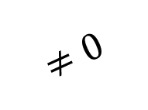


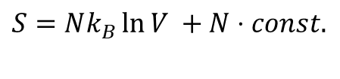




$$ΔS=S_{final}−S_{initial}$$
$$S=Nk_{B}\ln{\frac{V}{N}} +Nk_{B}+N⋅const.$$
Distinguishable
$$S=Nk_{B}\ln{V} +N⋅const.$$
Indistinguishable
$$V,N$$
$$2V$$
Gibbs paradox
$$≠0$$
If distinguishable
$$S$$
$$S$$
$$2S$$
$$ΔS=2Nk_{B}\ln{2V}−2⋅\left(Nk_{B}\ln{V}\right)=2Nk_{B}\ln{2}$$
Stephen J. Blundell and Katherine M. Blundell 2010

Slide 3
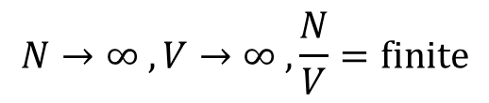


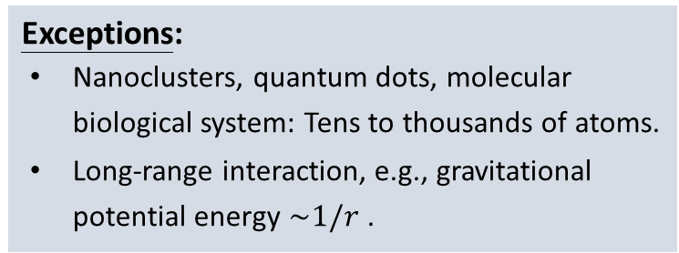
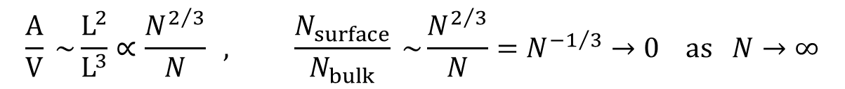

Entropy – extensivity
Scales with the size of the system. (e.g., U, V, N, S)
$$S\left(λU,λV,λN\right)=λS(U,V,N)$$
Exceptions:
Nanoclusters, quantum dots, molecular biological system: Tens to thousands of atoms.
Long-range interaction, e.g., gravitational potential energy $\sim 1/r$ .
Limitations:
1. Thermodynamic limit:
2. Short-range interaction (or no interaction):
The interaction range between particles is much smaller than the scale of the system.
Surface and boundary wall effects become vanishingly small, leaving only bulk properties.
$$N→∞ , V→∞ , \frac{N}{V}=finite$$
$$N\sim {10}^{23} , V \sim L^{3}∝N$$
$$Ω_{total}≠Ω_{1}×Ω_{2}$$
$$\frac{A}{V} \sim \frac{L^{2}}{L^{3}}∝\frac{N^{2/3}}{N} , \frac{N_{surface}}{N_{bulk}} \sim \frac{N^{2/3}}{N}=N^{−1/3}→0 as N→∞$$

Slide 4
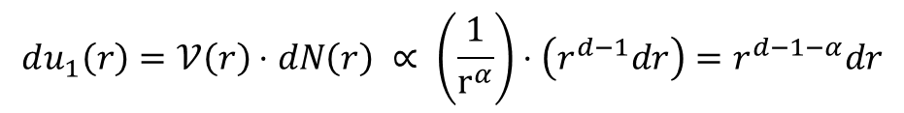

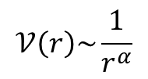
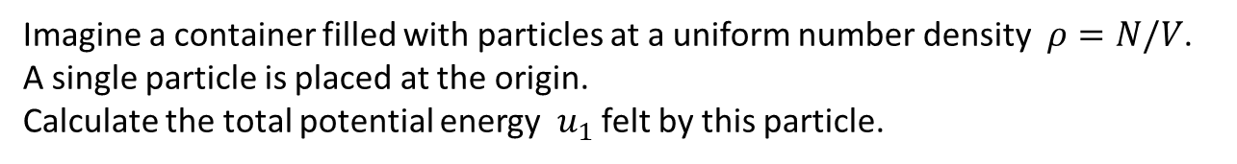


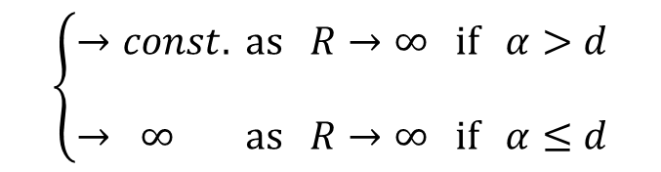

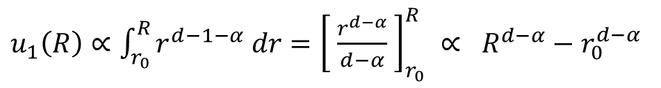
Long-range or short-range?
$$dV=S_{d}r^{d−1}dr$$
$$ρ$$
…
…
Imagine a container filled with particles at a uniform number density $ρ=N/V$.
A single particle is placed at the origin.
Calculate the total potential energy $u_{1}$ felt by this particle.
$$r$$
$$dN\left(r\right)=ρdV=ρS_{d}r^{d−1}dr$$
$$𝒱\left(r\right)\sim \frac{1}{r^{α}}$$
$$du_{1}\left(r\right)=𝒱\left(r\right)⋅dN\left(r\right) ∝ \left(\frac{1}{r^{α}}\right)⋅\left(r^{d−1}dr\right)=r^{d−1−α}dr$$
$$\left\{\begin{aligned}→const. as R→∞ if α>d \\ \\ → ∞ as R→∞ if α≤d\end{aligned}\right.$$
Short-range
$u_{1}\left(R\right)∝\int_{r_{0}}^{R}{r^{d−1−α} dr}={\left[ \frac{r^{d−α}}{d−α} \right]}_{r_{0}}^{R} ∝ R^{d−α}−$ $r_{0}^{d−α}$
Long-range

Slide 5
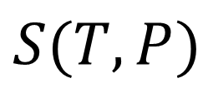
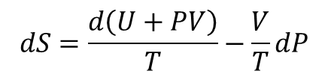
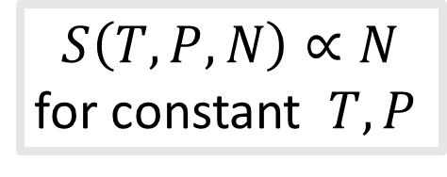
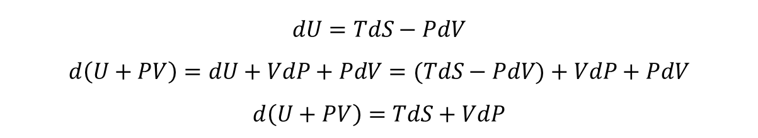
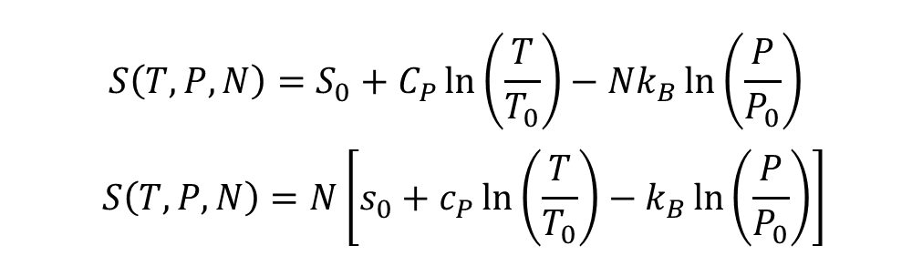


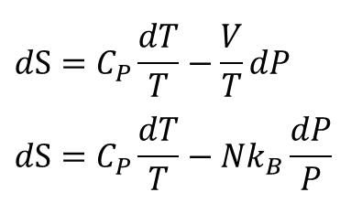
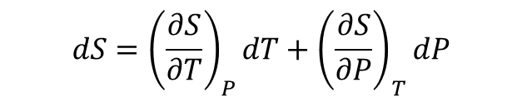
Entropy – an extensive quantity for Ideal Gas
Scales with the size of the system. (e.g., U, V, N, S)
$$dU=TdS−PdV$$
$$d\left(U+PV\right)=dU+VdP+PdV=(TdS−PdV)+VdP+PdV$$
$$d\left(U+PV\right)=TdS+VdP$$
$$S(T,P)$$
$$dS={\left(\frac{∂S}{∂T}\right)}_{P}dT+{\left(\frac{∂S}{∂P}\right)}_{T}dP$$
$$dS=\frac{d\left(U+PV\right)}{T}−\frac{V}{T}dP$$
For constant pressure,
$$d\left(U+PV\right)=TdS=đQ_{rev}=C_{P}dT$$
$$dS=C_{P}\frac{dT}{T}−\frac{V}{T}dP$$
$$dS=C_{P}\frac{dT}{T}−Nk_{B}\frac{dP}{P}$$
Ideal gas equation $PV=Nk_{B}T$
$$S\left(T,P,N\right)=S_{0}+C_{P}\ln\left(\frac{T}{T_{0}}\right)−Nk_{B}\ln\left(\frac{P}{P_{0}}\right)$$
$$S\left(T,P,N\right)=N\left[s_{0}+c_{P}\ln\left(\frac{T}{T_{0}}\right)−k_{B}\ln\left(\frac{P}{P_{0}}\right)\right]$$
$$S\left(T,P,N\right)∝N$$
for constant $T,P$
Postulate:
The entropy is a continuous and differentiable function of the extensive variables.
per particle

Slide 6

Demo
$$S∝N$$
extensivity

Slide 7
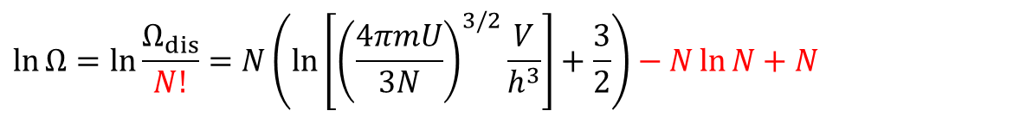

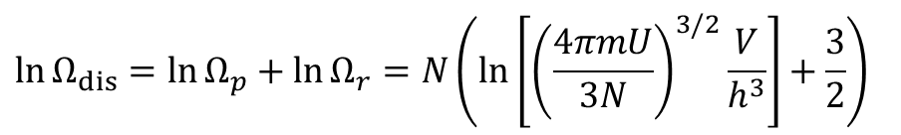
Gibbs paradox
$$U=\frac{3}{2}k_{B}T$$
Distinguishable
Ideal gas
$$\ln{Ω_{dis}}=\ln{Ω_{p}}+\ln{Ω_{r}}=N\left(\ln\left[{\left(\frac{4πmU}{3N}\right)}^{3/2}\frac{V}{h^{3}}\right]+\frac{3}{2}\right)$$
$$S=k_{B}\ln{Ω_{dis}}=k_{B}N\left(\ln\left[{\left(\frac{4πmU}{3N}\right)}^{3/2}\frac{V}{h^{3}}\right]+\frac{3}{2}\right)=k_{B}N\left(\ln\left[{\left(\frac{2πmk_{B}T}{h^{2}}\right)}^{3/2}V\right]+\frac{3}{2}\right)= Nk_{B}\ln{V} +N⋅const.$$
Indistinguishable
$$\ln{Ω}=\ln{\frac{Ω_{dis}}{N!}}=N\left(\ln\left[{\left(\frac{4πmU}{3N}\right)}^{3/2}\frac{V}{h^{3}}\right]+\frac{3}{2}\right)−N\ln{N}+N$$
$$S=k_{B}\ln{Ω}=k_{B}N\left(\ln\left[{\left(\frac{2πmk_{B}T}{h^{2}}\right)}^{3/2}\frac{V}{N}\right]+\frac{3}{2}+1\right)= Nk_{B}\ln{\frac{V}{N}} +Nk_{B}+N⋅const.$$

Slide 8
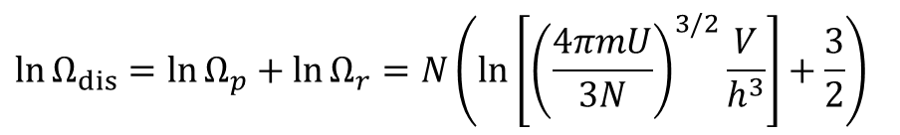
Gibbs paradox
$$U=\frac{3}{2}k_{B}T$$
Distinguishable
Ideal gas
$$\ln{Ω_{dis}}=\ln{Ω_{p}}+\ln{Ω_{r}}=N\left(\ln\left[{\left(\frac{4πmU}{3N}\right)}^{3/2}\frac{V}{h^{3}}\right]+\frac{3}{2}\right)$$
$$S=k_{B}\ln{Ω_{dis}}=k_{B}N\left(\ln\left[{\left(\frac{4πmU}{3N}\right)}^{3/2}\frac{V}{h^{3}}\right]+\frac{3}{2}\right)=k_{B}N\left(\ln\left[{\left(\frac{2πmk_{B}T}{h^{2}}\right)}^{3/2}V\right]+\frac{3}{2}\right)= Nk_{B}\ln{V} +N⋅const.$$
Indistinguishable
identical
$$\ln{Ω}=\ln{\frac{Ω_{dis}}{N!}}=N\left(\ln\left[{\left(\frac{4πmU}{3N}\right)}^{3/2}\frac{V}{h^{3}}\right]+\frac{3}{2}\right)−N\ln{N}+N$$
$$S=k_{B}\ln{Ω}=k_{B}N\left(\ln\left[{\left(\frac{2πmk_{B}T}{h^{2}}\right)}^{3/2}\frac{V}{N}\right]+\frac{3}{2}+1\right)= Nk_{B}\ln{\frac{V}{N}} +Nk_{B}+N⋅const.$$

Slide 9

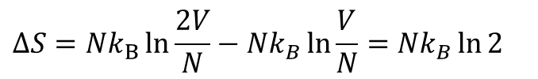

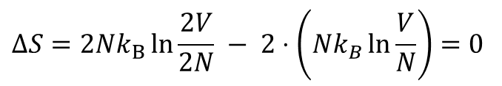


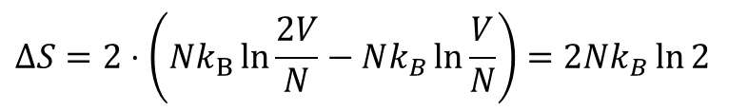

$$ΔS=S_{final}−S_{initial}$$
$$S=Nk_{B}\ln{\frac{V}{N}} +Nk_{B}+N⋅const.$$
Distinguishable
$$S=Nk_{B}\ln{V} +N⋅const.$$
Indistinguishable
$$V,N$$
$$2V$$
$$ΔS=Nk_{B}\ln{\frac{2V}{N}}−Nk_{B}\ln{\frac{V}{N}}=Nk_{B}\ln{2}$$
$$ΔS=2⋅\left(Nk_{B}\ln{\frac{2V}{N}}−Nk_{B}\ln{\frac{V}{N}}\right)=2Nk_{B}\ln{2}$$
$$ΔS=2Nk_{B}\ln{\frac{2V}{2N}} − 2⋅\left(Nk_{B}\ln{\frac{V}{N}}\right)=0$$
$$S$$
$$S$$
$$2S$$
Stephen J. Blundell and Katherine M. Blundell 2010

Slide 10
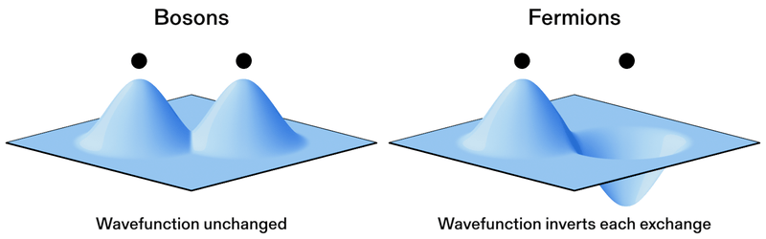

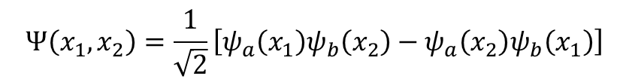
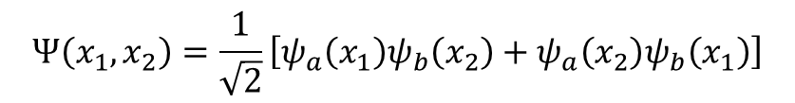
Identical particles
(the same mass $m$, charge $q$, spin $s$)
e.g., photon
e.g., electron, proton, neutron
$$Ψ\left(x_{1},x_{2}\right)=\frac{1}{\sqrt{2}}\left[ψ_{a}\left(x_{1}\right)ψ_{b}\left(x_{2}\right)+ψ_{a}\left(x_{2}\right)ψ_{b}\left(x_{1}\right)\right]$$
$$Ψ\left(x_{1},x_{2}\right)=\frac{1}{\sqrt{2}}\left[ψ_{a}\left(x_{1}\right)ψ_{b}\left(x_{2}\right)−ψ_{a}\left(x_{2}\right)ψ_{b}\left(x_{1}\right)\right]$$
NIST (美國國家標準與技術研究院)/anyon animation

Slide 11







Look up for exchange (permutation) operator. It has to be not only unitary but also its square is an identity matrix which guarantees real eigenvalues.
Identical particles
Due to the quantum nature, we are dealing with identical particles that cannot be distinguished from one another. Let us take a simple two-particle system for example,
The wave function for the two particles occupying i and j states can be written as
is the single particle wave function of state i
Since we are not able to distinguish them, we expect that
which gives rise to two possibilities,
1.
This kind of particles is boson.
wave function is symmetric under exchange of particles.
2.
This kind of particles is fermion.
wave function is antisymmetric under exchange of particles.
For fermions, if ,
No doubly-occupied state
(Pauli exclusion principle)

Slide 12
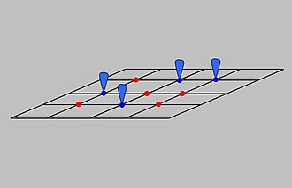
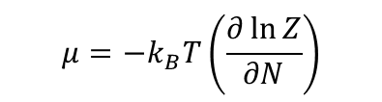
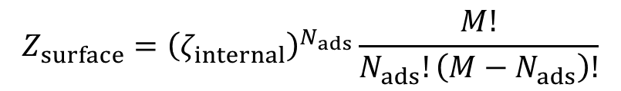
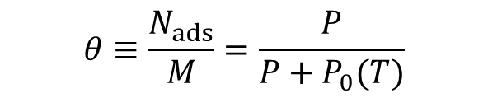
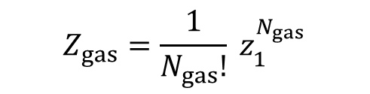


Surface chemistry --- Langmuir adsorption (吸附) model
$$Z_{surface}={\left(ζ_{internal}\right)}^{N_{ads}}\frac{M!}{N_{ads}!\left(M−N_{ads}\right)!}$$
ideal gas
$$Z_{gas}=\frac{1}{N_{gas}!} z_{1}^{N_{gas}}$$
Indistinguishable
$$μ=−k_{B}T\left(\frac{∂\ln{Z}}{∂N}\right)$$
$$(dU=TdS−PdV+μdN)$$
(perfectly flat plane)
$$μ_{surface}=μ_{gas}$$
immobile state
$$θ≡\frac{N_{ads}}{M}=\frac{P}{P+P_{0}(T)}$$
The fraction of the surface sites covered with adsorbates.
Assumptions:
All sites are equivalent.
No interactions.
We should consider indistinguishability of ideal gas. If not, the physics will be wrong.
(Wikipedia/Langmuir adsorption model)

Slide 13
Demo
Langmuir adsorption

Slide 14
Demo
Mixing entropy

Slide 15
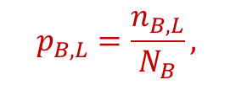

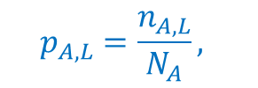

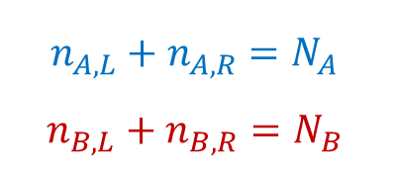
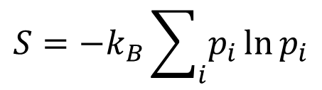

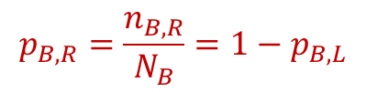

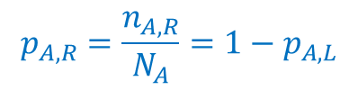
Gibbs entropy
$$N_{A}$$
$$N_{B}$$
$$S=−k_{B}\sum_{i}{p_{i}\ln{p_{i}}}$$
$$n_{A,L}+n_{A,R}=N_{A}$$
$$n_{B,L}+n_{B,R}=N_{B}$$
$$n_{A,L} n_{B,L}$$
$$n_{A,R} n_{B,R}$$
open
$$p_{A,L}=\frac{n_{A,L}}{N_{A}},$$
$$p_{A,R}=\frac{n_{A,R}}{N_{A}}=1−p_{A,L}$$
$$p_{B,L}=\frac{n_{B,L}}{N_{B}},$$
$$p_{B,R}=\frac{n_{B,R}}{N_{B}}=1−p_{B,L}$$
$$ΔS_{inst}^{A+B}\left(t\right)=−Nk_{B}\left[p_{A,L}\ln{p_{A,L}}+p_{A,R}\ln{p_{A,R}}\right]−Nk_{B}\left[p_{B,L}\ln{p_{B,L}}+p_{B,R}\ln{p_{B,R}}\right]$$

Slide 16
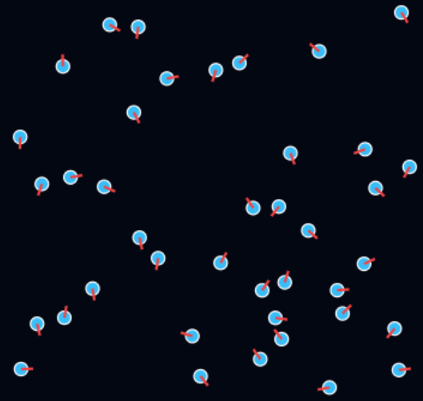
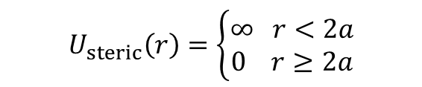
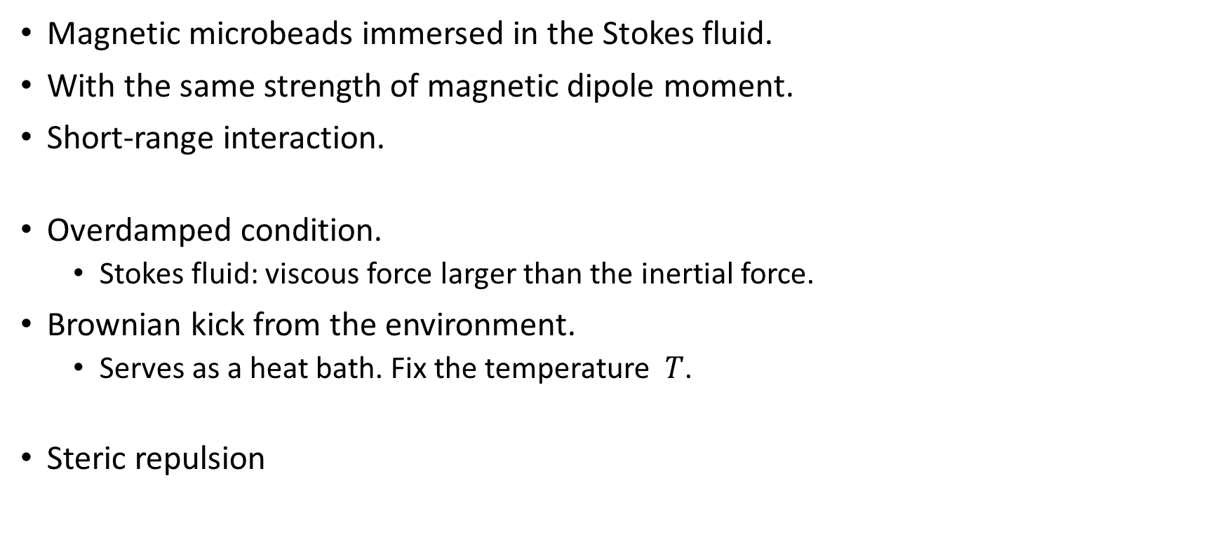
Interaction example in the Demo
Magnetic microbeads immersed in the Stokes fluid.
With the same strength of magnetic dipole moment.
Short-range interaction.
Overdamped condition.
  Stokes fluid: viscous force larger than the inertial force.
Brownian kick from the environment.
  Serves as a heat bath. Fix the temperature $T$.
Steric repulsion
(the same as in ideal gas case.)
$$U_{steric}\left(r\right)=\left\{\begin{aligned}∞ r<2a \\ 0 r≥2a\end{aligned}\right.$$

Slide 17

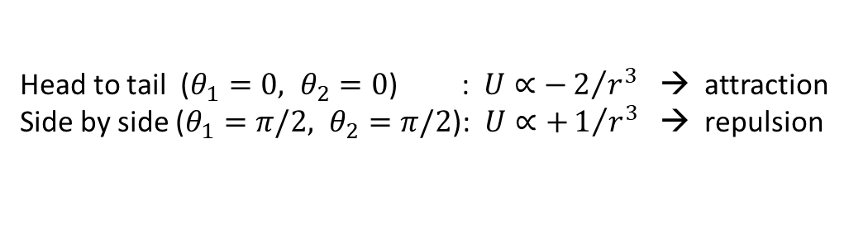



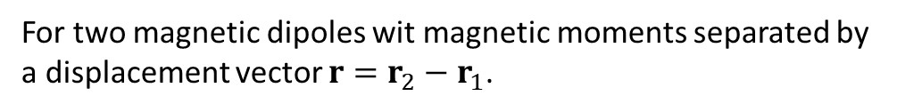



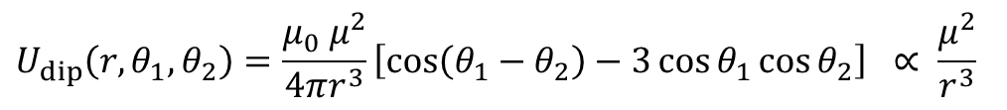

Magnetic dipole interaction
$$m_{2}$$
$$θ_{2}$$
$$m_{1}$$
$$θ_{1}$$
$$r$$
$$r_{1}$$
$$r_{2}$$
For two magnetic dipoles wit magnetic moments separated by a displacement vector $r=r_{2}−r_{1}$.
$$U_{dip}\left(r,m_{1},m_{2}\right)=\frac{μ_{0}}{4πr^{3}}\left[m_{1}⋅m_{2}−3\left(m_{1}⋅\hat{r}\right)\left(m_{2}⋅\hat{r}\right)\right]$$
Magnetic dipole moment $m=μ \hat{n}$.
In 2D coordinate, $m_{1}, m_{2}$ with $θ_{1}$ and $θ_{2}$ relative to the displacement vector $r$.
$$U_{dip}\left(r,θ_{1},θ_{2}\right)=\frac{μ_{0} μ^{2}}{4πr^{3}}\left[\cos\left(θ_{1}−θ_{2}\right)−3\cos{θ_{1}}\cos{θ_{2}}\right] ∝ \frac{μ^{2}}{r^{3}}$$
Head to tail ($θ_{1}=0, θ_{2}=0$) : $U∝−2/{r^{3}}$ → attraction
Side by side ($θ_{1}=π/2, θ_{2}=π/2$): $U∝+1/{r^{3}}$ → repulsion

Slide 18


Magnetic dipole interaction
$$m_{2}$$
$$θ_{2}$$
$$m_{1}$$
$$θ_{1}$$
$$r$$
$$r_{1}$$
$$r_{2}$$
Interparticle force
$$F_{12}=−∇U_{dip}=\frac{3μ_{0}}{4πr^{4}}\left[\left(m_{1}⋅\hat{r}\right)m_{2}+\left(m_{2}⋅\hat{r}\right)m_{1}+\left(m_{1}⋅m_{2}\right)\hat{r}−5\left(m_{1}⋅\hat{r}\right){(m}_{2}⋅\hat{r})\hat{r}\right]$$
Torque
$$τ_{1}=m_{1}×B_{2}(r_{1})$$
$$B_{2}\left(r_{1}\right)=\frac{μ_{0}}{4πr^{3}}\left[3\left(m_{2}⋅\hat{r}\right)\hat{r}−m_{2}\right]$$

Slide 19
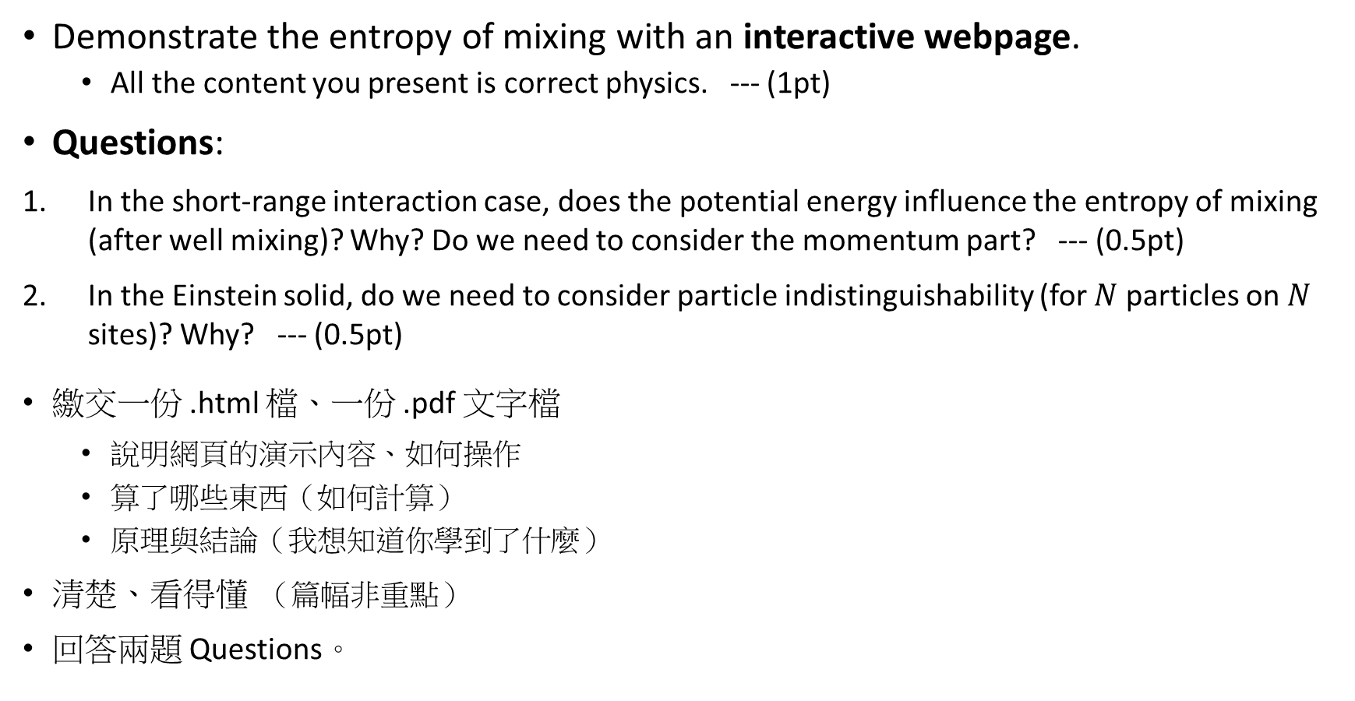
Assignment
Demonstrate the entropy of mixing with an interactive webpage.
  All the content you present is correct physics. --- (1pt)
Questions:
In the short-range interaction case, does the potential energy influence the entropy of mixing (after well mixing)? Why? Do we need to consider the momentum part? --- (0.5pt)
In the Einstein solid, do we need to consider particle indistinguishability (for $N$ particles on $N$ sites)? Why? --- (0.5pt)
繳交一份 .html 檔、一份 .pdf 文字檔
  說明網頁的演示內容、如何操作
  算了哪些東西（如何計算）
  原理與結論（我想知道你學到了什麼）
清楚、看得懂 （篇幅非重點）
回答兩題 Questions。

Slide 20
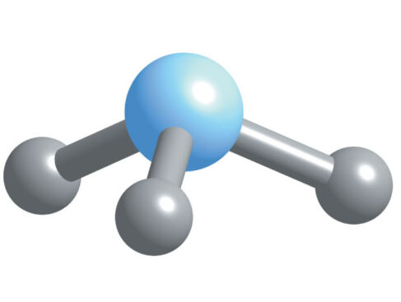
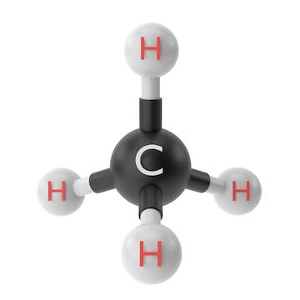
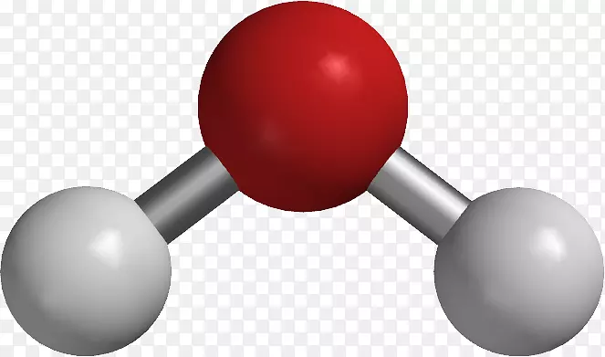
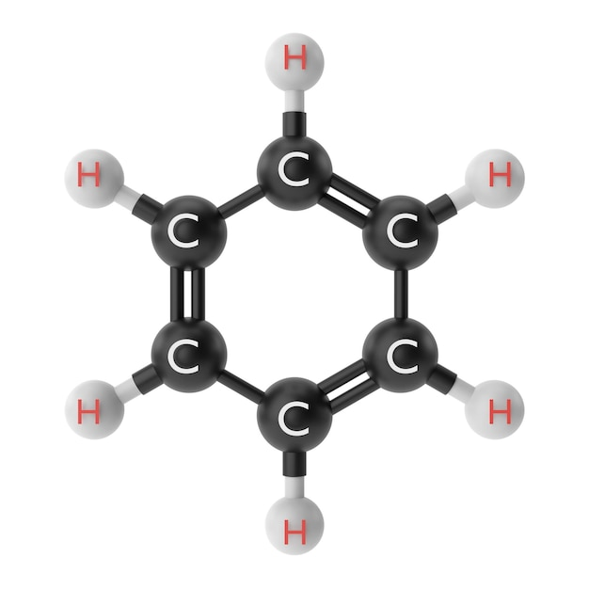





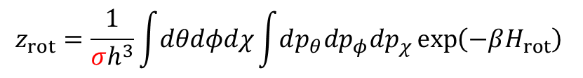











Indistinguishable configuration
--- Rotational symmetry of polyatomic molecules
$$H_{2}O$$
$${NH}_{3} Ammonia (氨)$$
$$CH_{4} Methane (甲烷)$$
$$O$$
$$N$$
$$3$$
$$12$$
$$2$$
$$H$$
$$H$$
$$H$$
$$H$$
$$H$$
Partition function of rotation
$$z_{rot}=\frac{1}{σh^{3}}\int{dθdφdχ}\int{dp_{θ}dp_{φ}dp_{χ}\exp\left(−βH_{rot}\right)}$$
$$C_{6}H_{6} Benzene (苯)$$
How many identical configurations?
$$12$$
What would happen if we didn’t consider the rotational symmetry?
Chemical equilibrium constants $K_{eq}$ to predict the chemical reactions.
Calculates the reaction rate from the partition function.

